Slide 1
Credit Card Primer
Decision Analytics Team

Slide 2

Contents
Credit Card Basics
  Introduction
  Credit Card Income Statement
  Credit Card Industry Overview
Credit Card Analytics
  Customer Life Cycle
  Customer Life Cycle Risk Management
    Introduction
    Customer Acquisition
    Customer Management
    Collections and Fraud
    Loss Forecasting
  Project Illustration: Customer Retention
Confidential

Slide 3




Consumer Financial Services Overview
Capital Market
Consumer Financial Services
$
Lending Services
Savings & Investment
  Installment loans
  Auto loans
  Mortgages
  HELOC’s
  Credit Cards
  Overdrafts etc.
  Checking accounts
  Savings accounts
  Certificates of deposits
  Mutual funds
  Insurance etc.
$
$
Financial Intermediary
Borrowers
Savers
Financial Institutions make money by borrowing at lower rate (e.g. 4.5%) and lending it at high rate of interest (e.g. 11.99%)
Confidential

Slide 4
What is a credit card?
Credit is a form of a trust which allows you to pay later for an item you purchase now, for a charge (interest or finance charge). A credit card is a proof that someone has given you credit, which can be used to make purchases. When you pay by a credit card, you are telling a seller, “The card issuer has authorized me to buy your product without cash and has guaranteed your payment.”
Key Features
Buy Now Pay Later (Credit):
  Credit card allows card holders to make a purchase and make the payment at a later date without charging any money/fees
  Typically 20-30 days time (grace period) is provided to make payment to credit card issuing company
Part Payment (Revolving Credit):
  Card holder can choose between making full payment to the card issuer OR only make a portion of total amount due.
  However, a card holder is required to pay a minimum amount by a specified date, which is decided by the card issuer. Card holder who make part payment are called Revolvers. Delay in making the payment by due date results in late fee which is charged to card holder
APR (Finance charge/Interest):
  Annual Percentage Rate is the interest (also called Finance Charge), charged on portion of the purchase amount which is not paid within free credit period.
  It can be fixed percentage as well as variable percentage. Different APRs are assigned to different card holders depending upon their credit worthiness (ability to pay back)
Credit Limit:
  Credit Limit is the maximum amount that can be used by the card holder to make purchases without paying back to the card company. However, there are some credit cards which do not assign fixed limit on its usage
Confidential

Slide 5
Types of Credit Card
Credit-cards encompass a spectrum of products with annual fees, credit limit and acceptance as key differentiators.
Product | Characteristics | Example
Credit Card | Basic Credit Card with option to revolve Specific Credit Limit Offers Grace Period May or may not have Annual fees Interest income is the key revenue component for the issuer | Cards issued by Citibank, Amex
Charge Card | Payment in full at the end of billing cycle No Credit Limit Offers Grace Period Has Annual fees Offers extra “convenience” like preferential bookings | Cards issued by GE, Amex
Rewards based Card | Offers incentives like reward points, cash back, airline discounts/miles etc Has annual fees Encourage loyalty | Cards issued by Discover
Private Label Card | Store/chain specific - Not accepted at other locations Encourage loyalty | Cards issued by Shell
Confidential

Slide 6
Buy & Sell chain for Credit Card Industry
Credit card industry consists of 5 types of players
Participant | Role | Benefits | Costs
Cardholder | Card members use the card for goods, services or cash. He can be either a transactor (who pays the account in full on or before the due date) or a revolver (someone who makes monthly payments) | Access to credit Convenience of not carrying cash Use of bonus features Ability to time payments | Interest rate and fees
Merchants (e.g. shops) | Provides goods and/or services to the card member. They must abide by the rules set forth by the association and acquirer | Access to large no of consumers Ability to sell to consumer unable to pay cash or pay upfront without risk | Need to pay interchange fees as a % of Sales
Acquiring Bank | This group is the merchant’s bank. It has an agreement with a merchant to be in its program and accept Visa or MasterCard as payment for goods or services. They provide authorization terminals and support services | Shares in interchange fees from merchant | Operation costs Fraud risks
Card Association | MasterCard & Visa each has its member banks that are granted the right to offer either (or both) MasterCard & Visa. Associations conduct clearing (transaction data) and settlement (debits to issuers, credits to acquirer) for transactions, and develop new systems and technologies | Shares in interchange fees from merchant | Operation costs Fraud risks
Issuing Bank | Member banks that issue a credit card to their customers with their logo. Issuers issue cards, receive and pay for transactions, maintain authorization files, bill and collect from card members for transactions, process payments and provide customer care | Interest rates from card holders Fees from card holders Interchange fees from Merchant Ability to cross sell product | Operation costs Fraud risks Credit risks
Confidential

Slide 7



Transaction Overview
a. Parties Involved
Consumer
Merchant
Purchases Goods or Services
McDonalds, Macy’s...
Network
Facilitates Transaction
Sends Bill
Sends Receipts
Credits Account
Issuer
Acquirer
Consumer’s Bank (Issuer) Citibank, Amex,…
Visa, Master Card, Amex, Discover
Merchant’s Bank (Acquirer): Citibank, Amex,...
Presents Receipts
Sends Funds
Confidential

Slide 8
Transaction Overview
b. Information and Fund Flow
Information Flow
Consumer
Swipe of credit card
Merchant
On authorization, signing of voucher
Routing of transaction amount and cardholder details to acquirer issuer
Returning authorization to merchant
Issuer
Routing of details to issuer
Acquirer
Authorization / Decline of transaction
Funds Flow
Consumer
Merchant
Network
$100
$0.01-0.02
$98
Issuer
Bank
$98.7
Acquirer
Interchange fees (Discount Revenue)
1.25-3%
Confidential

Slide 9
Credit Card Income Statement
Confidential

Slide 10


What Is Income Statement?
Income statement is a financial statement that contains a summary of a business’ financial operations for a specific period of time. It shows the net profit or loss for period by stating the company’s revenues and expenses, and hence, it is also names as Profit and Loss (P&L) Statement.
- | Revenues
- | Expenses
- | Losses
- | Taxes
= | Net Income
Confidential

Slide 11
What are the revenue items in credit card P&L?
Finance Charges | Interest paid by the card holder on revolving balances during the cycle
Late Fee | Fees charged for occurrences of the late payments (not received on/before due date)
Over the Limit Fee | Fees charged for occurrences of transactions over the card holders predetermined credit limit
Balance Transfer Fee | Fees charged for transferring a balance from one financial institution to another financial institution (a minimum fee or a percentage of the balance)
Access Check Fee | Fees charged for access checks written against the card holder’s account
Cash Advance Fee | Fees charged for over the counter or ATM cash advances
Annual Fee | Membership fees are charged to the cardholder account on an annual basis. Not all accounts in a given portfolio pay an annual fee, based on account performance and profitability, and some portfolios do not charge an annual fee.
Enhancement Services Income | Fee charged for enhancement services products such as account secure or dining club
Interchange | Percentage of each dollar of merchant sales that the acquirer are required to pay the issuer; the issuer is required to pay part of the compensation to VISA / MasterCard Association
Misc. Fees | Check by Phone Foreign Conversion Fee Non-Sufficient Funds Fee Rush Processing Fee
Confidential

Slide 12
What are the expense items in credit card P&L?
Cost of Funds (Interest Expense) | Expense for funding the receivables in the portfolio
Marketing Origination Expenses | All expenses associated with the account acquisition phase of booking new accounts
Marketing Portfolio Management Expenses | All expenses related to the administration of the accounts in the portfolio and ongoing portfolio management programs
Operating Expenses | Fixed and variables expenses associated with the operations of the business including collection & customer services expense
Partnership Share | Payments made to partners in connection with the origination of accounts and subject to the provisions of the specific partner agreements
Confidential

Slide 13
What are Losses?
Losses = Charge-offs
Bankruptcy Chargeoff
Credit Chargeoff
Fraud Chargeoff
Customer files for Bankruptcy; the financing company takes the hit
Inability / disinterest to pay the dues
Intentional misrepresentation to obtain Credit
Chargeoff Interest | Interest previously billed to cardholders that will not be realized due to account balance charge-off
Chargeoff Fees | Fees previously billed to cardholders that will not be realized due to account balance charge-off
Chargeoff Principal | Total receivables (net of interest and fees) deemed to be uncollectible
Confidential

Slide 14
Profit & Loss Statement
Illustrative
Alternative Channels (in 000s) | Jan | Feb | March
Finance Charges | 14,139 | 13,126 | 13,256
Late Fee | 9,049 | 8,523 | 5,462
Over the Limit Fee | 7,055 | 6,952 | 8,453
Balance Transfer Fee | 234 | 362 | 453
Access Check Fee | 123 | 245 | 213
Cash Advance Fee | 84 | 123 | 145
Annual Fee | 320 | 149 | 156
Enhancement Services Income | 1,834 | 2,030 | 2,135
Interchange | 1,961 | 2,302 | 2,453
Misc. Fee | 1,712 | 2,321 | 1,456
Total Revenue | 36,511 | 36,133 | 34,182
Interest Expense | 2,723 | 3,651 | 2,853
Marketing Origination Expense | 1,523 | 1,682 | 1,620
Marketing Portfolio Management Expense | 523 | 652 | 952
Operating Expense | 3,820 | 3,952 | 3,215
Compensation | 650 | 654 | 852
Total Expenses | 9,239 | 10,591 | 9,492
Chargeoff Interest | 1,878 | 2,314 | 1,896
Chargeoff Fees | 3,256 | 3,521 | 3,456
Chargeoff Principal | 11,499 | 11,423 | 11,232
Total Chargeoff | 16,633 | 17,258 | 16,584
Pretax Income | 10,639 | 8,284 | 8,106
Tax | 3,936 | 3,065 | 2,999
Net Income | 6,703 | 5,219 | 5,107
Confidential

Slide 15
Credit Card Industry Overview - US
Confidential

Slide 16
Credit Card History
1950 – The concept of paying merchants using a card was invented by Ralph Schneider and Frank X. McNamara of The Diners Club. They produced the first “general purpose” Charge Card (entire bill to be paid with each statement)
1960 – Bank of America created the BankAmericard, a product which eventually evolved into a Visa system (“Chargex” also became Visa)
1966 – MasterCard came to being when a group of credit-issuing banks established MasterCharge
There are now countless variations on the basic concept of revolving credit for individuals such as organization-branded cards, corporate-user cards, store cards and so on.
InterBank Card Associations (Master Card) Bank of America begins Franchising BankAmericard
1966
Flatbush National Bank Issues Charge-it (script)
1946
Sears
1959
Discover
1985
Optima
1987
GM Card
1991
1950
Diner’s Club (T&E)
1958
American Express
1960
Bank Americard (VISA)
1990
AT&T Universal Card
Confidential

Slide 17
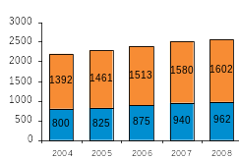
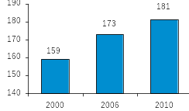
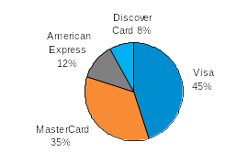

Credit Card Industry Size & Facts: US
Consumer Credit Outstanding¹, $ billion
Credit Cardholders in US²
The US revolving consumer debt, made up almost entirely of credit card debt, was about $962 billion
There were 173 million credit card holders in US in 2006, and the number is expected to reach 181 million by 2010
Revolving
Non Revolving
Credit Card Receivables Outstanding³
Customer Profile
Visa and MasterCard held 80% of the $972.7 billion in general purpose card outstanding in 2008
Households with more than 1 credit card³ |  | 78%, 91.1 million
Average outstanding credit card debt for households that have a credit card³ |  | $10,679
Average cards per customer by the fourth quarter of 2008⁴ |  | 5.4
Federal Reserve Statistical Release
US Census Bureau
Nilson Report
Experian Marketing
Confidential

Slide 18
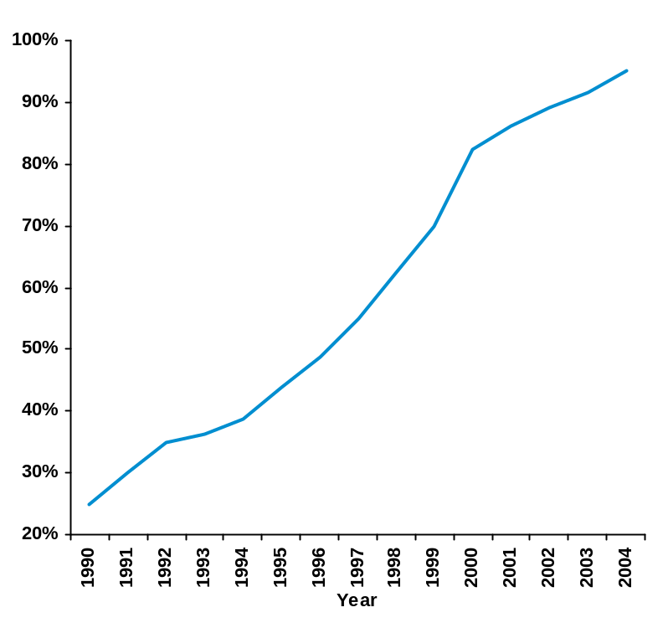
Industry Consolidation
Industry has been consolidating significantly since the middle of the ’90’s
The top 10 issuers now account for 90% of market share
Market Share of Top Ten General Purpose Credit Card Issuers8
Acquirer | Acquired Company | Year | Cost (In BN)
Chase | Chemical | 1996 | 13
Bank One | First USA | 1997 | 23
Citi | AT&T | 1997 | 15
Fleet | Advanta | 1997 | 11
Bank One | Chevy Chase | 1998 | 5
Bank One | First Chicago | 1998 | 18
Bank of America | Nations | 1998 | 9
MBNA | First Union | 2000 | 6
Citi | Associates | 2000 | 6
Bank One | Wachovia | 2001 | 7
Chase | Providian | 2002 | 8
HSBC | Household | 2003 | 17
Citi | Sears | 2003 | 11
JP Morgan | Bank One | 2004 | 76
Bank of America | Fleet | 2004 | 17
Bank of America | MBNA | 2005 | 35
HSBC buys Household $17B
Citi buys Sears $11B
Chase buys part of Providar $8B
MBNA buys First Union $6B
Citi buys Associats $6B
JPM Chase buys Bank One $76B
Bank of America buys Fleet $17B
Bank One buys First USA $23B
Citi buys AT&T $15B
Fleet buys Advanta
Bank One buys Wachovia $7B
Bank One buys Chevy chase $5B
Bank of America buys Nations $9B
Bank One buys First Chicago $18B
Chase busy chemical $13B
Confidential

Slide 19
Top Credit Card Issuers
The top 10 U.S. credit card issuers held 87.6% of $972.7 billion in general purpose card outstanding in 2008, up from 84.70% in 2007
Top Issuers in US, Outstanding¹
Top Issuers in US, Total Volume¹
End of 2008
$ billion, % Change over 2007
End of 2008
$ billion, % Change over 2007
Rank | Issuer | Outstanding | %Change
1 | Chase | 183.32 | 21.8
2 | Bank of America | 166.32 | 1.3
3 | Citi | 106.74 | -3.5
4 | American Express | 88.02 | -9.0
5 | Capital One | 60.08 | 1.9
6 | Discover | 49.69 | 3.7
7 | Wells Fargo | 36.36 | 37.9
Rank | Issuer | Volume | % Change
1 | American Express | 457.23 | 2.4
2 | JP Morgan Chase | 378.49 | 4.6
3 | Bank of America | 327.74 | -3.5
4 | Citigroup | 259.53 | -4.3
5 | Discover | 105.73 | -0.8
6 | Capital One | 102.72 | -18.1
7 | US Bank | 74.24 | 5.4
Nilson report
Confidential

Slide 20
Top Credit Card Acquirers
The top 10 acquirers contributed 87.05% of the total purchase volume of $2.8 trillion in 2007, down from 89.27% in 2006
Top Acquirers in US, Purchase Volume¹
Top Acquirers in US, Transactions²
End of 2007
$ billion, % Share of Total Volume
End of 2007
billion, % Change over 2007
Rank | Company | Volume | Share
1 | Chase Paymentech Solutions | 599.37 | 28.02%
2 | First Data | 353.51 | 16.53%
3 | BA Merchant Services | 279.87 | 13.09%
4 | Nova Information Systems | 171.99 | 8.04%
5 | Fifth Third Bank | 154.87 | 7.24%
6 | Wells Fargo Merchant Services | 86.43 | 4.04%
7 | Global Payments | 83.15 | 3.89%
8 | Heartland Payment Systems | 51.94 | 2.43%
9 | First Nat’l Merchant Solutions | 46.67 | 2.18%
10 | RBS Lynk | 34.01 | 1.59%
Rank | Company | Transactions
1 | Chase Paymentech Solutions | 9.78
2 | First Data | 6.72
3 | BA Merchant Services | 6.54
4 | Fifth Third Bank | 1.72
5 | Nova Information Systems | 3.43
6 | Global Payments | 1.06
7 | Heartland Payment Systems | 1.30
8 | Wells Fargo Merchant Services | 1.18
9 | Alliance Data | 0.70
10 | RBS Lynk | 0.81
Nilson report; Purchase volume is for Visa and MasterCard credit and debit cards only
Nilson report; Purchase transactions are generated by Visa & MasterCard credit and debit cards, American Express, Discover, Diners, and JCB credit cards
Confidential

Slide 21


Major Networks/Associations
Credit card networks can be classified as two types – proprietary and open networks
Proprietary networks, such as American Express (in US) and Discover, operate as issuer, acquirer, and network operator
Open networks are comprised of member banks that can be issuers, acquirers or both. The network sets the interchange fees, which are paid by acquirers to issuers
MasterCard vs. Visa
Parameter | Category
 |  | Q1, 2009 | Q1, 2008 | Growth% | Q1, 2009 | Q1, 2008 | Growth%
Purchase Volume, $ billion¹ | Credit | 113 | 131 | -14% | 203 | 218 | -7%
 | Debit | 79 | 75 | 5% | 206 | 195 | 6%
Card Base, million¹ | Credit | 239 | 278 | -14% | 334 | 365 | -8%
 | Debit | 127 | 116 | 9% | 333 | 295 | 13%
Digital Transactions
Confidential

Slide 22
Recent Trends – Regulations in US Market
The new credit card regulations enforced by Obama, aimed at consumer protection are also expected to impact the credit card issuer’s margins as well as consumer’s ability to obtain credit
Time to Payment | Legislation | Bills to be mailed 21 calendar days before due date (current minimum notification period is 14 calendar days)
 | Implications | Potential change in billing structure
Protection against Arbitrary Rate Increases | Legislation | Consumers wouldn't face a retroactive interest rate increase on existing balances unless payments are 60 days overdue Also, the companies have to provide at least 45 days' notice before changing any significant terms on a card Even after the rate increase, a consumer could get the old rate reinstated by paying on time for six months Also, the card holder will always have option of opting out by paying off all his dues at the existing interest rate
 | Implications | Limit credit card issuer’s ability to price according to the risk Potential impact on margins
Ban on Double-Cycle Billing | Legislation | The legislation bans a practice in which a late-paying consumer is assessed interest on a prior month's balance that had been paid in full, in addition to the late balance
 | Implications | Potential impact on margins
Fair allocation of payments | Legislation | For customers with balances subjected to multiple interest rates, payments in excess of the minimum due must first be applied to those balances with the highest rate
 | Implications | Potential loss in margin for customers who use more expensive credit instrument - BT, Cash, Cheque
Actions
Credit card issuers are expected to take some actions to mitigate the potential losses expected to arise as a result of the new regulations
  Charging annual fee
  Fewer promotional rates and offers
  Reducing the reward programs
Some issuers are already increasing rates for consumers ahead of the new rules as they try to protect against losses
Issuers are also expected to cut credit lines for consumers deemed risky
Confidential

Slide 23
Credit Card Industry Overview - UK
Confidential

Slide 24

Credit Card Industry Size & Facts: UK
Spending on plastic cards amounted to £354.2 billion in 2006, which comprised £221 billion on debit cards, and £133.2 billion on credit and charge cards
Market Presence¹
Customer Profile in 2007¹
There were 165.4 million payment cards in issue in 2007 of which credit cards constituted 41%, i.e. 67.3 million
The average transaction value stood at £63.22
The average number of credit cards per person stood at 2.4
Credit Card Market Performance², at year end
The credit card market has seen negative growth in 2008 over the previous year in its key performance indicators
Parameters | 2008 | 2007 | Growth %
Credit Outstanding Volume, £ billion | 65.5 | 65.2 | 0.4%
Total Cards in Issue, million | 66.7 | 67.4 | -1.0%
Total Accounts, million | 56.3 | 58.1 | -3.1%
Active Accounts³, million | 35.2 | 36.5 | -3.6%
APACS (Association for Payment Clearing Services)
British Banker’s Association Statistics
Active accounts: Accounts that have a balance outstanding at year end
Confidential

Slide 25










Top Credit Card Issuers
Barclaycard ranked¹ highest as the strongest credit card brand in UK. This position was partially supported by its large market share and a high level of brand awareness
Barclaycard² is one of the top credit card issuers in UK. It has 23 million customers in the UK, across Europe and the United States with 11.7 million customers in UK alone
Its profit before tax increased by 31% over 2007 to reach £789 million
The Capital One Group³ is a top ten credit card issuer in the UK
Worldwide, it has more than $147 billion in managed loans and approximately 50 million customers, serviced by 27,000 employees
1
2
Strongest Brands: Rank 3 to 10
Online Card Issuer
Egg Banking⁴ plc is a British internet bank. Formerly called Prudential Banking plc, Egg is now the world's largest internet bank
It is currently owned by Citi. Egg specializes in savings, credit cards and loans but also offers mortgage and insurance products
Auriemma Consulting Group 2008 Report
2008 Annual Report and website
Website
Wikipedia
Confidential

Slide 26
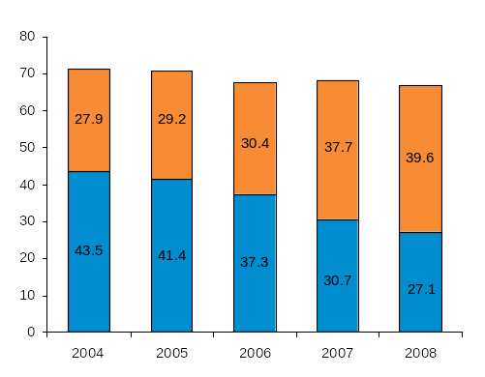
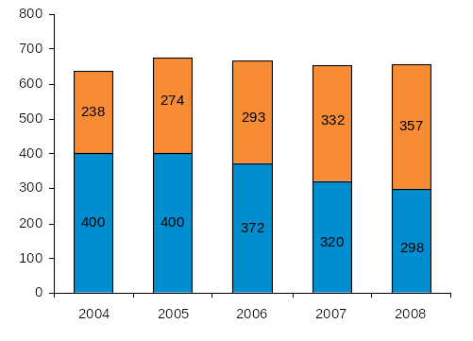
Major Networks/Associations
Mastercard has been consistently gaining share of the total credit outstanding volume as well as the number of cards in issue at the expense of Visa
Credit Outstanding, £ billion¹
Number of Cards in Issue, million¹
Total Credit Outstanding at the end of 2008 stood at £65.5 billion, a CAGR of 1% over 2004 and only 0.4% than a year earlier
Total number of cards in issue at the end of 2008 stood at 66.7 million, a CAGR of 2% over 2004 and -1% than a year earlier
VISA
VISA
MasterCard
MasterCard
Total = Visa + MasterCard; Source: British Banker’s Association Statistics
Confidential

Slide 27
Contents
Credit Card Basics
  Introduction
  Credit Card Income Statement
  Credit Card Industry Overview
Credit Card Analytics
  Customer Life Cycle
  Customer Life Cycle Risk Management
    Introduction
    Customer Acquisition
    Customer Management
    Collections and Fraud
    Loss Forecasting
  Project Illustration: Customer Retention
Confidential

Slide 28
Customer Life Cycle
Confidential

Slide 29
The Credit Customer Life Cycle – Business Issues
Targeting Prospects
Booking
Accounts
Managing Customers
Cross-Sell
Targeting Prospects: Who is my target customer, and how do I interest him/her in my product?
Booking Accounts: Once target or other prospective customers are interested in my product, how do I select and book those I want?
Managing Customers: Once the customer is in my portfolio, how do I maintain, control, and grow the relationship?
Confidential

Slide 30
The Credit Customer Life Cycle – Business Decisions
Targeting
Prospects
Booking
Accounts
Managing
Customers
Mail / don’t mail / how frequently / channel?
Target prospect / customer?
Tier pricing?
Timing
Accept/Reject?
Tier pricing?
Initial credit line?
Upsell / downsell / offer alternate products?
Increase / decrease credit line?
Collect?
Authorize?
Reissue?
Tier Pricing?
Customer service level?
Cross-Sell
Confidential

Slide 31
Customer Life Cycle Risk Management
Confidential

Slide 32
What is Risk?
Risk = Uncertainty (about an outcome)
+
Exposure (to Loss)
Example1
A person is trying to cross a busy road when the signal is yellow. He might be hit by a vehicle or he may
escape from all vehicles. Outcome is uncertain
If he is hit by a vehicle then he will suffer personally. Exposure is involved. Hence, he is facing a risk
Example2
A person is trying to cross a road which is isolated and is not used by vehicles. He is certain that he will
not be hit by a vehicle. Outcome is certain. Hence he does not face a risk
Confidential

Slide 33
What is Risk Management?
A process of measuring, assessing and mitigating/ avoiding loss/ less than expected returns. It involves developing & executing strategies at every stage where Risk is involved. Strategies Include
  Transferring this risk to another party,
  Avoiding the risk,
  Reducing the negative effect of the risk, and
  Accepting some or all of the consequences of a particular risk.
Example: A person is trying to cross a busy road may either
1. Wait for the signal to turn Red and then cross the road – In this case he is totally eliminating the Risk of being hit by a vehicle but has to wait for little more time before he crosses
2. Take some Risk and carefully cross the Road. In this case he is exposed to the risk of getting hit but gets a return of crossing early.
Confidential

Slide 34

Risk Management Toolbox
Financial Markets have various types of Risks but our primary focus is on Credit Card. While lending money or issuing credit card, if we choose a customer who doesn’t repay, then we stand to lose Money. This type of risk is called Credit Risk
Credit Bureaus
Bureau Scores (e.g. FICO Score)
Fraud Detection System
Behavioral Scores
Account Management System
Profit Models
Application Processing System
Challenger Strategies
Collection / Recovery System
Data Warehousing
Prediction
Information
Implementation
Confidential

Slide 35
Risk Management Toolbox
Financial Markets have various types of Risks but our primary focus is on Credit Card. While lending money or issuing credit card, if we choose a customer who doesn’t repay, then we stand to lose Money. This type of risk is called Credit Risk
Credit Bureaus
Bureau Scores (e.g. FICO Score)
Fraud Detection System
Behavioral Scores
Account Management System
Profit Models
Application Processing System
Challenger Strategies
Collection / Recovery System
Data Warehousing
Prediction
Information
Implementation
Confidential

Slide 36
Credit Card – Lifecycle Management
Ability
Gather Information about various Products available
Compare parameters such as APR, Fees, and credit limit.
Apply for a credit card
Make purchases or cash withdrawals through credit card
Receive billing information on fees and finance charges
Keep track of rewards being offered on card usage
Voluntary Attrition: Switch to a card offering better terms or rewards
Involuntary Attrition: Card deactivated due to non payment of dues
Face Legal proceedings
Pay Back
Willingness
Default
Counseling
Customer
Customer Management
Customer Acquisition
Customer Retention
Customer Attrition
Recoveries
Issuer
Identify potential customers
Approach customers through DM/EM/Other channels
Monitor Response rates and costs
Application Processing
Monitor Card Usage Patterns
Give appropriate rewards to retain customers
Inform customers about their payment details, financial charges and fees
Keep track of Delinquencies
Analyze attritions and identify causes
Try to reduce attrition through better customer service, cross selling etc.
In case of involuntary attrition, proceed with recoveries
Send reminders to defaulters
Offer customer counseling and incentives for repayment of loan
Start legal proceedings if needed
Confidential

Slide 37
Customer Acquisition
Customer Acquisition
Customer Management
Recoveries
Customer acquisition is a business term used to describe the influx of customers or clients
Confidential

Slide 38
Customer Acquisition
Customer Management
Recoveries
What are the important decisions for Customer Acquisition?
Whom to give Credit?
How much Credit to be assigned?
What is the right pricing?
Confidential

Slide 39


Whom to give Credit?
Customer Acquisition
Customer Management
Recoveries
An application is screened for various attributes and relative risk is evaluated through Credit Risk Scores Depending on the assessed risk, the application is either approved or declined
Target: Maximize Approval Rate within Loss guidelines, Minimize Queue Rate for Manual Approval
“Pre Qualified” type customer
Hand over the Credit Card
Above Minimum permissible score*
Hand over the Credit Card**
Internal Customer
“Invite To Apply” type customer
Internal Application Scorecard*
Below Minimum permissible score
Reject Application
Customer Applies for Credit Card
“Neither Pre Qualified nor Invite To Apply” type customer
Above Minimum permissible score*
Hand over the Credit Card**
External/Open Market Application Scorecard
External
Customer
Below Minimum permissible score
Reject Application
* When the internal customer declares his/her Customer ID, the system identifies where he/she would belong and an appropriate scorecard is selected to score that customer. Based on the study and strategy, application of 2 Cut-off or 1 Cut-off points, the score bands and min-permissible score will be decided
** Decision Framework and Policy papers are referred to while making customized and specific Pre Qualified offers
Confidential

Slide 40
How much Credit to be assigned?
Customer Acquisition
Customer Management
Recoveries
Line assigned at acquisition is to accommodate the need of the account after the initial months of acquisition.
After we have sufficient performance of the account we start considering the account for CLI or CLD
While acquiring the account, we do not know how the account would perform on our books. Hence we try to play safe and line assignment is conservative in nature
Credit limit assigned is aligned to the risk associated with the customer. Apart from risk we can also consider need and profitability of the customer
Need
# of Enquiries
# of Open lines
% Utilization on other cards
Bureau Scores
Payment Behavior
(on other cards)
Delinquency History
Total Balance build over time in other cards
Extent of revolve behavior in other cards
Risk
Profitability
All three factors determine credit limit assigned to the account
Confidential

Slide 41
What is the right Pricing?
Customer Acquisition
Customer Management
Recoveries
Pricing for a particular offer entails
Annual fee
A.P.R.
  Variable vs. fixed
Grace Period
Ancillary fees
Rebates
Typically, APR is aligned to the risk associated with the customer. Most of the other components remain same within a product offer. Higher the risk, higher will be the APR charged to the customer
We can change the APR based on the performance of the account. If account shows defaulting we rise the APR as he becomes more risky to handle
Confidential

Slide 42
Customer Management
Customer Acquisition
Customer Management
Recoveries
Various initiatives taken by the Credit card issuer to retain Customers and increase the card usage
Confidential

Slide 43
Customer Acquisition
Customer Management
Recoveries
What are the important decisions in Customer Management?
Whom to give increase/decrease in line and by how much?
Balance Transfers (BTs): Whom to offer and how much?
Authorizations: Should overlimit/delinquent transactions be approved?
Repricing: Which are the most risky accounts and should they be upward repriced?
Other Functions: Inactive account management/Card Reissue
Confidential

Slide 44
Credit Line-Why?
Customer Acquisition
Customer Management
Recoveries
The objective is to build balances and drive profitability through
Credit Line Increases to Right People
  Higher Line
  Higher Sales
  Higher Balances
  Higher Profits
Credit Line Decrease to Potential Loss Making Accounts (CLDs)
Lower Line
Lower Loss Exposure
Confidential

Slide 45
CLIs - How?
Customer Acquisition
Customer Management
Recoveries
Credit Line Increase (CLI) can either be a:
  Proactive Increase: Assessing Risk & Profitability of an account at every cycle or end of month and sending out CLI increase letter
  Reactive Increase: When credit needy customer calls and requests for CLI, we assess their risk and then grant increase to deserving customers
In either scenario, accounts are flowed through certain rule sets and are assigned lines accordingly
Confidential

Slide 46
CLIs – An Example
Customer Acquisition
Customer Management
Recoveries
(CLI_TBL = T4) Highest Line Assignment Table
Current Credit limit | Utilization | External Balance
 |  | <$1,500 | Missing | $5,000+
$1,000 - <$2,500 | 25%-<40% | $0 | $1,000 | $1,000
 | 40%-<80% | $800 | $1,000 | $1,000
 | 80%+ | $1,500 | $1,500 | $1,500
$2,500 - <$5,000 | 25%-<40% | $0 | $2,000 | $2,000
 | 40%-<80% | $2,000 | $2,000 | $2,000
 | 80%+ | $2,000 | $2,500 | $2,500
$5,000 - <$10,000 | 25%-<40% | $0 | $0 | $2,000
 | 40%-<80% | $2,000 | $2,000 | $3,000
 | 80%+ | $2,000 | $2,500 | $3,000
$10,000 - <$20,000 | 25%-<40% | $0 | $0 | $2,500
 | 40%-<80% | $2,000 | $2,000 | $3,000
 | 80%+ | $2,500 | $2,500 | $3,000
$20,000 - <$25,000 | 25%-<40% | $0 | $0 | $2,500
 | 40%-<80% | $2,000 | $2,000 | $3,000
 | 80%+ | $2,500 | $2,500 | $3,000
An Account with
Current line b/w $5,000-$10,000
Utilization b/w 40-80%
External Balance of <$1,500
Will get a Line Increase of $2,000
The rules are derived using Segmentation tool and Optimization Exercise
Confidential

Slide 47
CLDs - Why/How?
Customer Acquisition
Customer Management
Recoveries
As a part of the monthly adjustments, we identify high risk accounts and decrease their line in order to reduce loss exposure
Other Loss Mitigation Initiatives:
  ELMO: Early Life Loss Mitigation Opportunity
    To reduce exposure on risky accounts which are just 0-3 months on books
  ARM: Authorization Risk Model
To reduce exposure on Risky accounts which are > 3 months on books.
The model leverages recent transactions while assessing risk
Confidential

Slide 48
Example
Customer Acquisition
Customer Management
Recoveries
Typical Factors considered for Line Decrease
All Accounts
1. Global Criteria
A typical actioned account
2. Line Module Criteria
Credit Limit before Action | $3,000
Account Balance | $1,500
Credit Line after action (1.02* Balance, rounded to next 100) | $1,600
Saved Exposure | $1,400
3. Credit limit
$600+
4. Months Since Line Increase
7+
5. Months Since Line Decrease
4+
6. Cycles Delinquent
0
1
7. Months On Book (MOB)
6+
8. Payment % of Balance
6 Months
0%-1%
1%-5%
5%-39%
39%-74%
A buffer to avoid account going Overlimit on next transaction
9. Charge-off Score
100-720
10. Bankruptcy Score
100-700
Control
Test
Confidential
Notes:
Global Criteria: Applied across all accounts, eg. Never delinquent
Line Module Criteria: Existing Line, historical actions on the line

Slide 49
Balance Transfers – Why?
Customer Acquisition
Customer Management
Recoveries
Balance Transfer is the process of moving an outstanding balance from one credit card to another
Card Issuer: If I offer the customer a lower APR on his other cards balances , and if he accepts the offer, then I will be able to
  Build Balances
  Protect profitable balances via the payment hierarchy
  Engage customers and prevent customer attrition/inactivity
  Extend customer lifecycle
Card Holder: If I accept the offer and transfer my balances from higher rate to my card, then I will be able to
  a) Consolidate all my debt
  b) Enjoy lower interest charges on my balance
Confidential

Slide 50
Balance Transfers – How?
Customer Acquisition
Customer Management
Recoveries
Global / BT Criteria
E.g.. Accounts with NSF
Or Line <$1000 are excluded
Does an account pass our Global Risk/ BT criteria?
What Rate/Offer should be made to the customer?
Is the person going to respond to our offer?
Offer Segmentation
Identify Segments based on Usage, Risk, MOB, APR
Analyze Response behavior
Responsive
Not Responsive
BT Offer is Mailed to Customer
BT Offer resides in Sales Engine
Confidential

Slide 51
An Example
Customer Acquisition
Customer Management
Recoveries
Inactivity Flag | MOB | Retail Balance | 3-Mos Avg. Interest Yield | BT Risk Score | Total Balance (EOM) | External Balance | BT's Segment
Y | NA | NA | NA | NA | NA | NA | Inactive, S/E
Y | <24 | NA | NA | NA | NA | NA | Inactive, New Accts
 | >=24 | NA | NA | >=680 | NA | NA | Inactive, Low Risk
 |  |  |  | <680 |  |  | Inactive, High Risk
N | 0-10 | <=0 | NA | NA | NA | NA | New, No Retail
 |  | >0 |  |  |  |  | New, with Retail
 | 11-14 | <=0 | NA | NA | NA | NA | Graduation, No Retail
 |  | >0 |  |  |  |  | Graduation, with Retail
 | >=15 | NA | <8% | >=770 | NA | NA | Low Yield, Low Risk
 |  |  |  | 680-<770 |  |  | Low Yield, Medium Risk
 |  |  |  | 450-<680 |  |  | Low Yield, High Risk
 |  |  |  | <450 |  |  | Low Yield, Highest Risk
 |  |  | >=8% | >=770 | <1000 | <7K | High Yield, Low Risk, Low Bal, Low Ext Bal
 |  |  |  |  |  | >=7K | High Yield, Low Risk, Low Bal, High Ext bal
 |  |  |  |  | >=1000 | NA | High Yield, Low risk, High Bal
 |  |  |  | 680-<770 | <1000 | <7K | High Yield, Med Risk, Low Bal, Low Ext Bal
 |  |  |  |  |  | >=7K | High Yield, Med Risk, Low Bal, High Ext Bal
 |  |  |  |  | >=1000 | NA | High Yield, Med Risk, High Bal
 |  |  |  | 450-<680 | NA | NA | High Yield, High Risk
 |  |  |  | <450 |  |  | High Yield, Highest Risk
BT Risk – Profitability & Segmentation
I am a High Yield, Low Risk Customer. I can transfer my balances @ 4.99%. Plus if I transfer, I can fly to Hawaii for free
I am a Low Yield, Medium Risk Customer. I can transfer my balances @ 10.99%. Plus I have to return it in 6 months
Confidential

Slide 52
Authorizations-How?
Customer Acquisition
Customer Management
Recoveries
Strategy
Time on Books
Delinquency
Balance
Charge Off Score
Approve
Decline
Current & Under-limit Transactions get approved through Authorization Systems
Other high risk transactions like Delinquent and/or Over-limit transaction flow through strategy coded system
Confidential

Slide 53
An Example
Customer Acquisition
Customer Management
Recoveries
Customer A
Sale Amount | $200
Credit Limit | $1,500
Account Balance | $1,000
Remaining Credit | $500
Delinquency | None
Block Code | None
Customer B
Sale Amount | $700
Credit Limit | $1,500
Account Balance | $1,000
Remaining Credit | $500
Delinquency | None
Block Code | None
Customer C
Sale Amount | $200
Credit Limit | $1,500
Account Balance | $1,000
Remaining Credit | $500
Delinquency | 2
Block Code | F
Clean Transaction
Decision - Approve
Over-Limit Transaction
Decision - Decline
Delinquent Transaction
Decision - Decline
Confidential

Slide 54
Re-Pricing: Why?
Customer Acquisition
Customer Management
Recoveries
The interest rate (APR) at which the credit offer is made to the customers may get changed during the life cycle through
  Risk Based Repricing (e.g. Score deterioration)
  Trigger based Repricing (e.g. 2 times 2 due* in 6 months)
The action may result in Canceling Promotion Rate or bringing an account to the Default Rate (the max. rate that can be charged on the card (e.g. Prime +23.99%)
Over a period of time if an account exhibits Good behavior (Underlimit and Non Delinquent) then account can be Cured back to its Original Rate (but can never get back the Promotional Rate): Curing
* 60 days past billing
Confidential

Slide 55
Re-Pricing: How?
Customer Acquisition
Customer Management
Recoveries
Typical Factors considered for Repricing
Typical Decisions Made
1. Late Fee
Change from promotional (4.99%) to go to rate (9.99%), or
Change from go to rate to default rate (16.99%)
2. Delinquency
3. Over limit
Trigger
Low (Late Fee not X-day*)
Severity of trigger
High (x-day or OVL)
Promo Rate
No Promo Rate
Promo Rate (OVL Only: Exempted)
No Promo Rate
Clean
1
Go To Rate
Exempt = 100%
2
Default Rate
Exempt = 100%
3
Go to Rate
Exempt = 0%
4
Default Rate
Exempt = 100%
Tarnished
5
Go To Rate
Exempt = 0%
6
Default Rate
Exempt = 100%
7
Go to Rate
Exempt = 0%
8
Default Rate
Exempt = 100%
Dirty
9
Go To Rate
Exempt = 0%
10
Default Rate
Exempt = 0%
11
Go To Rate
Exempt = 0%
12
Default Rate
Exempt = 0%
* No X days: 0 days past billing
Confidential

Slide 56
An Example
Customer Acquisition
Customer Management
Recoveries
Month: May 08
Month: June 08
Customer A
BT Balance | $1,000
BT Rate | 4.99%
Retail Balance | $500
Retail rate | 16.99%
Delinquency | None
Block Code | None
Customer B
BT Balance | $1,000
BT Rate | 16.99%
Retail Balance | $500
Retail rate | 16.99%
Delinquency | X Day
Block Code | None
PROMO Cancelled
Manage your account if you want to enjoy Promotional Rates
Confidential

Slide 57
A Synopsis
Customer Acquisition
Customer Management
Recoveries
Management
Focus
TOB
Activity
Risk
All Booked Accounts
BT/Lifecycle Programs
New Accounts
Inactive
Balance Build
Active
Low Risk
Balance Build
BT?CLI/Usage
High Risk
Loss Mitigation
ELMO/CLD
Mature Accounts
Inactive
Low Risk
Balance Build
BT/Activation/Usage Programs
High Risk
Loss Mitigation
Inactive Closure / Re-Issue Closure
Active
Low Risk
Balance Build
BT / CLI / Usage
High Risk
Loss Mitigation
Upward Reprice / ARM / CLD / Re-Issue Closure
Confidential

Slide 58
Collections
Customer Acquisition
Customer Management
Recoveries
Confidential

Slide 59
Collections - Overview
Customer Acquisition
Customer Management
Recoveries
What is Collections?
The process of claiming a due and receiving payment.
When does Collections happen?
When the accounts have gone unpaid for several months and the creditor has not received any communication from the consumer.
Why is Collections important for a business?
Collections will help in recovering the amount that is due but has not been paid back by the debtors.
Helps in increasing the Profit for a Credit card Company
Confidential

Slide 60
Collection Analytics
Customer Acquisition
Customer Management
Recoveries
Collection Efforts start as soon as customers start defaulting on their payments
Objective
Collect As Many Dollars Given Operating Plan Budget
- OR –
Attempt to Collect up to the Point Where Incremental Collections Effort Costs More Than Incremental Dollars Collected
Goal: Control Losses/Expenses
Increased Dollar Collected – Lower Delinquency & Loss
Reflect a Positive Image of Client Brand to the Cardholders
Ensure Compliant Behavior
Minimize Complaints
Confidential

Slide 61
Key Metrics
Customer Acquisition
Customer Management
Recoveries
Output Metrics
Aged Losses
Collection Effectiveness = CE: No of Dollars collected per Dollar spent
Net Flows: Net Movement from one delinquency bucket to other delinquency bucket
Self Cure Rate: Voluntary payments by customers to reduce their DPD status
Complaints:
Process Metrics
Penetration Rate
Contact Rates: No of people contacted/ No. of total calls made
Kept Rates: No of promises kept/No of promises
Dollars Collected
Confidential

Slide 62
Fraud Management
Credit Card – Loss Avoidance
Confidential

Slide 63
Fraud - Overview
What is Fraud?
Fraud is the intentional misinterpretation of truth in order to obtain credit (Identity, Income, Assets, Documents etc.)
What are different types of Fraud?
Event based fraud
  Application Fraud: Application fraud happens when a criminal uses stolen or fake documents to open an account in someone else's name
  Lost/Stolen: When a credit card is lost or stolen, it remains usable until the holder notifies the issuer that the card is lost allowing an unauthorized person to make unauthorized purchases on a card until it is canceled
  Non-Received: It occurs when new or replaced cards mailed by the card company are stolen during the process of being mailed
  Compromise: Identity theft resulting from copying card account information that include: Name of card holder, Account number, Expiration date, Verification/CVV code
  Takeover: Account takeover happens when a criminal tries to take over another person's account, first by gathering information about the intended victim, then contacting their card issuer masquerading as the genuine cardholder, and asking for mail to be redirected to a new address. The criminal then reports the card lost and asks for a replacement to be sent.
Transactional
  Internet: Information provided over internet for purchase of a product
  Counterfeit: Criminals use Counterfeit cards made using technology to skim information contained on the magnetic stripes of cards and to pass security features such as hologram
Payment Fraud
  Bustout: Bust Out is a scheme in which the identity and credit line of a business are used to get loans by an otherwise non-creditworthy borrower who has no intention of repaying.
Confidential

Slide 64
Fraud Management Life Cycle
Fraud Deterrence
Fraud Prevention
Fraud
Detection
Fraud Mitigation
Fraud Investigation
Continous Monitoring/Reporting
Fraud Deterrence: Deterrence, the first stage, is characterized by actions and activities intended to increase the difficulty of committing fraud effectively
Methods
    New advancements in technology e.g. induction of chip and pin in credit cards
    Continous monitoring of the trends
    Rule based strategies
Fraud Prevention: Prevention aims at capturing fraud before it actually occurs. E.g. capturing fraud at prescreening stage
Methods
    Efficient databases of bad customers
    Using credit bureau information for pre - screening out the customers
    Active collaboration with other issuer banks, network providers and external vendors
    Robust verification processes
Confidential

Slide 65
Fraud Management Life Cycle Contd..
Fraud Detection: Detection, is characterized by actions and activities intended to identify and locate fraud prior to, during, and subsequent to the completion of the fraudulent activity
Methods
  Fraud pattern recognition using statistical methods e.g. segmentation
  Using artificial intelligence techniques like Neural Networks to locate fraud
  Continous monitoring of the fraud trends
  Collaboration with the fraud operations
Fraud Mitigation: The goal of mitigation is to stop losses from occurring or continuing to occur and/or to hinder a fraudster from continuing or completing the fraudulent activity, by blocking an account and at the same time evaluating the impact on legitimate customers
Methods
  Developing strategies using various statistical methods
  Cost benefit analysis
  Efficient operations support
Confidential

Slide 66
Fraud Management Life Cycle Contd..
Fraud Investigation: Investigation activities obtain enough evidence and information to stop fraudulent activity, to obtain recovery of assets or restitution, and to provide information and support for the successful prosecution and conviction of the fraudster
Methods
  Internal investigation of the employees
  External investigation of the customers and fraudsters
  Coordination with the law enforcement entities
Continous Monitoring/Reporting: At each of the above mentioned stages it is necessary to have an effective and efficient reporting system to track
  Track current trends
  Track performance of the existing strategies
  Gain an insight on the specific problem areas
Confidential

Slide 67
Loss Forecasting
Credit Card – Loss Avoidance
Confidential

Slide 68
Loss Forecasting – Types of Losses
Losses = Charge-offs (primarily)
Bankruptcy Charge-off
Credit Charge-off
Fraud Charge-off
Customer files for Bankruptcy; the financing company takes a hit
Inability/disinterest to pay the dues (more than six consecutive delinquencies)
Intentional misrepresentation to obtain Credit
Confidential

Slide 69
Loss Forecasting Overview
Total Receivables
Losses
Total Income
Forecasting Charge-offs for a group of accounts (segment) / portfolio
Robust Forecasting
  Reduces the uncertainty and make losses more deterministic
  Provides a realistic picture of the Risk appetite
  Forms an integral part of various Risk & Marketing process ensuring compliance with legal and over sight activity
Confidential

Slide 70
Loss Forecasting stages
Loss forecasting
Segment level forecasts
Loss forecasting
Portfolio level forecasts
Accessing Risk
Loss forecasting input for PV calculation & selection
Monthly portfolio level loss forecasting & AOP
Customer Targeting
Underwriting Approval/Decline
Portfolio Management
Confidential

Slide 71
Methodologies
Methodologies
Best Usage
1. Net Flow Rates
Accuracy is high for revolving (6 month)
Best used if applied to homogeneous segment and rolled to portfolio level
Provides the highest degree of detail and offers insights and diagnostics
Forecast next 12-24 month level losses at portfolio level
Each month delinquency bucket / Delinquency bucket for prior month
Flow from current to delinquency to charge-off
2. Score Distribution
Reasonably accurate for forecasting short period losses
Efficiency increases with choices of segments and time period
Best technique for forecasting losses in a new segment
Actual losses by score distribution for portfolio segment
Forecast for other segments based on baseline losses
3. Vintage loss curves
Best if timing shift and overall economy change are accommodated
Tracks losses by month over life of a segment
Assumes recent segments will track along the same curve
Develop percentage of lifetime losses by each month
Forecasting is obtained by (actual losses to date)/(percentage of lifetime loss)
Confidential

Slide 72
Project Illustration: Customer Attrition
Confidential

Slide 73
Basic Framework to tackle Attrition
The four-step framework can be used to understand and arrest attrition
Four-step Framework
Profiling
Understanding our Attritors
Root Cause Analysis
Understanding why they attrited
Annual Spend Gain
$ XX Bn
Retention/ Treatment Strategies
Understanding how we can arrest attrition
Customer Level Targeting
Understanding which customers would be sensitive to treatment
Confidential

Slide 74

Attrition: Key Questions
Some of the questions we should answer to design the strategy for arresting attrition
What is Attrition?
Who are the attritors?
Who are the high value attritors we should focus on?
How did the customers behave before they attrited?
What can we do to arrest further attrition?
Whom did we try to retain?
How much can we save by arresting further attrition?
Confidential

Slide 75
Types of Attrition
Attrition can be defined by a combination of account cancellation, loss of spend and prior spend activity
Franchise Attrition
Customers who terminate all their accounts with the card issuer, and are spend active before such attrition
Attrition
Account Attrition
Attrition is a case of significant loss of spend from a customer, with or without cancellation of accounts
Customer who cancel some of their cards and reduce their spend after this attrition
Passive Attrition
Franchise & Account attrition can be voluntary as well as involuntary. Passive attrition is usually voluntary
Customer who do not cancel any of their cards, but drastically reduce their spend
Confidential

Slide 76
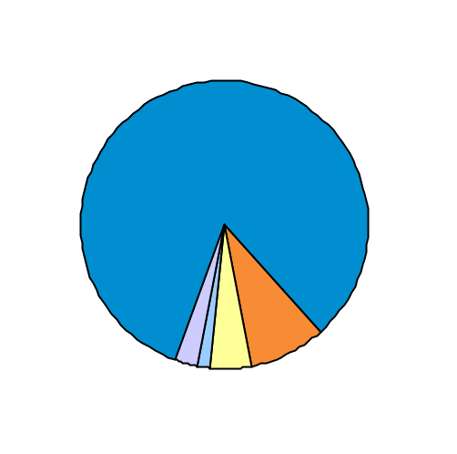
Profiling the Attritors
We do profiling to understand and appreciate the differences between attritors and non attritors
Attritor Profile in the year prior to attrition
Observing Attrition in the observation period
Non Attritors
Franchise Attritors
Account Attritors
Passive Attritors
Others¹
Profile
Customer count
# High Wallet Customers
Annual Consumer Spend
# Accounts per Customer
Avg. Monthly Balance
Avg. Rev. Balance
14.0 MM (82%)
4.7 MM
$ 11k
1.3
$ 2k
$ 2k
0.4 MM (2%)
0.08 MM
$ 6k
1.1
$ 1k
$ 1k
0.3 MM (2%)
0.1 MM
$ 14k
2.0
$ 4k
$ 2k
0.8 MM (5%)
0.2 MM
$ 7k
1.2
$ 2k
$ 2k
1.5 MM (9%)
0.5 MM
$ 11k
1.5
$ 4k
$ 3k
Confidential

Slide 77
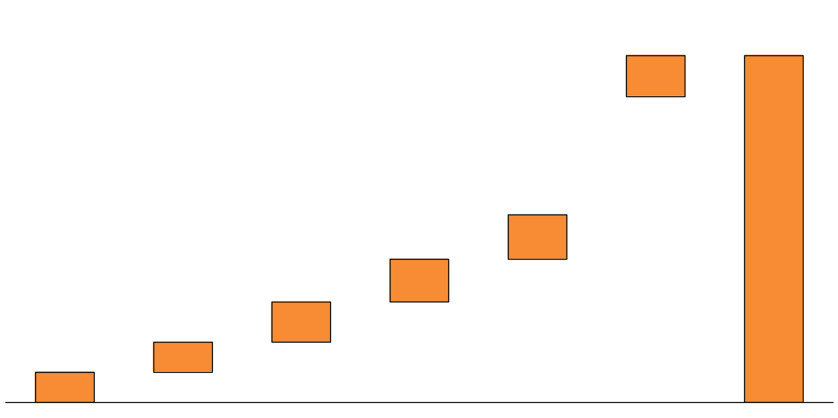
Root Cause Analysis
Identifying the root cause(s) of attrition will enable deployment of appropriate retention strategy
Root Cause Analysis
XX (100%)
37k (9%)
35k (9%)
36k (9%)
Annual Fee
Penalty Fee
Other card
acquisition
Over
Contacting
Poor Customer
Service experience
TBD
All Attritors
Confidential

Slide 78
End-to-end Retention Strategy
Potential retention/treatment strategies need to be developed for each of the root-causes behind attrition
Root Causes
 | Charging of Annual Fee | Charging of Penalty Fee | Other Card Acquisition | Poor Customer Service Experience | Over-contacting
Waive Annual Fee | ✓
Reinforce Benefits |  | ✓
Award Bonus points | ✓ |  | ✓ | ✓
Use only targeted contacts |  |  |  |  | ✓
Potential Treatments
Confidential

Slide 79
Customer Level Targeting
A combination of multiple factors - Sensitivity of customers to treatment strategy, Responsiveness to Channel and Expected customer value need to be evaluated together
Customer Level Targeting Framework
Low
Expected Customer Value
High
For each customer, identify the optimal combination of Treatment Strategy and Channel
High
Responsive to Treatment Strategy
Low
Low
High
Responsive to Channel of Contact
Confidential

